Slide 1
"GoldenBraid: A Standarized DNA Assembly System for Plant Synthetic Biology"
Fruit genomics and Biotechnology Group
Diego Orzaez, IBMCP, CSIC-UPV, Valencia

Slide 2
….in most labs multigene assembly is a bottleneck in the development of new complex plant traits.

Slide 3
Combining traits is easy.
Ideally, plant genetic parts and modules are better assembled at DNA level
Ideal features of a DNA assembly system for Plant Biotechnology:
-Standarized.
-Reusable pieces and modules.
-Simple (rules and toolkit).
-Efficient

Slide 4
Combining traits is easy
The GoldenBraid Assembly
An iterative cloning system for standardized assembly of reusable genetic modules.

Slide 5
Combining traits is easy.
GoldenBraid makes use of type IIS restriction enzymes
ctcgag
nnnn cctgag
Type II enzyme
Type IIS enzyme

Slide 6
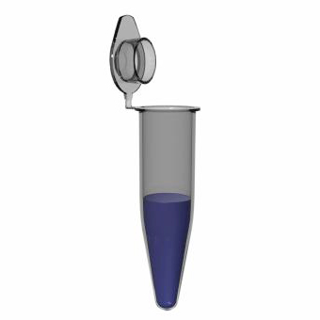
Combining traits is easy.
GoldenBraid is based on Golden Gate, an assembly system described previously:
The Golden Gate Assembly System
Golden Gate
One tube-one reaction
Golden Gate is a extreamly efficient, potentialy seamless multipartite assembly system
Engler C, et al (2009) PLoS One 4: e5553.
Engler C, Kandzia R, Marillonnet S (2008) PLoS One 3: e3647.

Slide 7
Combining traits is easy.
Golden Gate functions with TypeIIS restriction enzymes
pENTR_Part1
pENTR_Part2
BsaI
1
PART 1
3
BsaI
BsaI
3
PART 2
2
BsaI
1
BsaI
Lac Z
BsaI
2
pDEST

Slide 8
Combining traits is easy.
The Golden Gate Assembly System
One tube-one reaction:
Ligase + RE (cycles 16ºC and 37ºC)
PART 1
PART 2
pDEST
Seamless, multipartite assembly
High efficiency
Combinatorial

Slide 9
Combining traits is easy.
Golden Gate opened the way to multipartite assembly of standarized DNA pieces
pENTR_Term
BsaI
4
CDS
3
BsaI
pENTR_Term
pENTR_PROM
1
4
BsaI
3
TERM
2
BsaI
BsaI
PROM
BsaI
ctta
atgg
tgaa
ttgg
1
PROM
4
CDS
3
TERM
2
1
BsaI
Lac Z
BsaI
2
LB
pDEST
RB

Slide 10
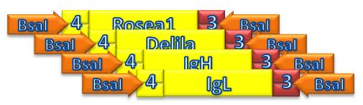
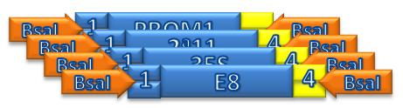
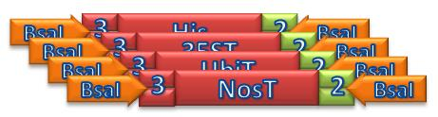
Combining traits is easy.
COLLECTION OF STANDARIZED PARTS
4-3
1-4
3-2
ctta
atgg
tgaa
ttgg
1
PROM
4
CDS
3
TERM
2
LB
RB
pEXPRESSION

Slide 11
Combining traits is easy.
END OF THE STORY…
Golden Gate did not allow multigene assembly.
ctta
atgg
tgaa
ttgg
1
PROM
4
CDS
3
TERM
2
LB
RB
pEXPRESSION

Slide 12
Combining traits is easy.
ACTUALLY, IT WAS THE START OF THE STORY…
The GoldenBraid Assembly System
Sarrión-Perdigones et al (2011) PloS One 6(7): e21622.

Slide 13
Combining traits is easy.
END OF THE STORY…UNLESS
ctta
atgg
tgaa
ttgg
BsbI
A
1
PROM
4
CDS
3
TERM
2
C
BsbI
LB
pEXPRESSION
RB

Slide 14
Combining traits is easy.
END OF THE STORY…UNLESS
Adding a second type IIS flanking sites to the destination plasmid, we can release the entire transcription unit (TU) and assemble it with another TU .
TRANSCRIPTIONAL UNIT 1
ctta
atgg
tgaa
ttgg
BsbI
A
1
PROM
4
CDS
3
TERM
2
C
BsbI
LB
pEXPRESSION
RB

Slide 15
GoldenBraid assembly
Combining traits is easy.
pENTR_Part1
pENTR_Part1
TU 1
TU 2
BsbI
A
C
BsbI
BsbI
C
B
BsbI
A
BsbI
Lac Z
BsbI
B
pDEST
End of the story again…?
This strategy allows joining two Transcriptional Units, but again we run out of restriction sites, what brings us to a dead end.

Slide 16
Combining traits is easy.
GoldenBraid uses a simple toolbox of 4 destination plasmids
(pDGBs)
A
1
Z
2
C
1
A
Z
B
3
pDGB_A12C
pDGB_1AB3
To solve this dead end we developed GoldenBraid, an iterative system that allows indefinite assembly of new TUs.
Level α plasmids
Level Ω plasmids
C
1
Z
2
B
3
A
Z
B
2
pDGB_C12B
pDGB_1AB3

Slide 17

Combining traits is easy.
The GoldenBraid Assembly System
P1 P2 P3
TU1
Golden GATE
TU1
TU2
P1 P2 P3
TU2
GoldenBraid
Golden GATE
16h to colonies!!
GoldenBraid takes multipartite Golden gate composite parts and assembly them binarely

Slide 18
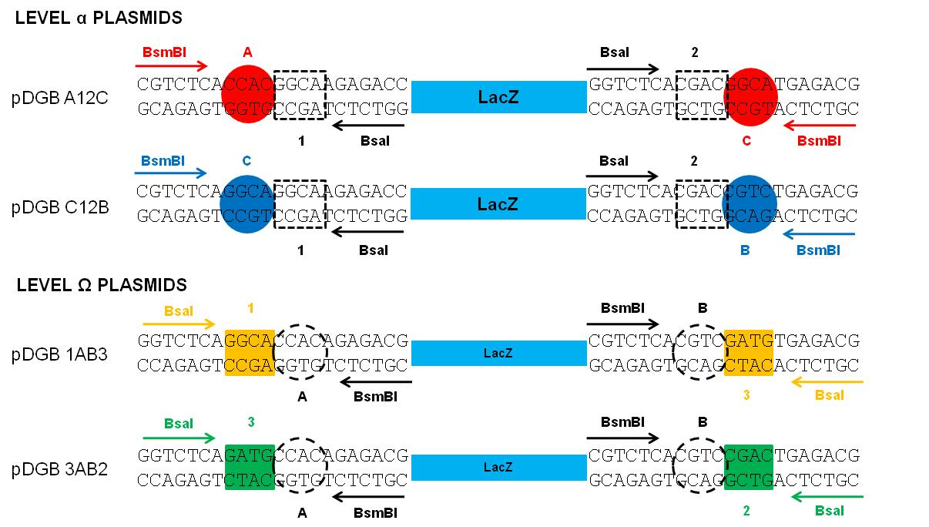
GoldenBraid assembly
Combining traits is easy.

Slide 19
Combining traits is easy.
The 4 pEDGBs give a doble-loop structure (braid)
A
1
Z
2
C
1
A
Z
B
3
pDGB_A12C
pDGB_1AB3
C
1
Z
2
B
3
A
Z
B
2
pDGB_C12B
pDGB_1AB3

Slide 20
Combining traits is easy.
Each destination plasmid performs a different “braid twist”
1
A
Z
B
3
pDGB_1AB3
TU1
A
C
1
3
TU2
C
B

Slide 21
Combining traits is easy.
In each “Braid twist” 2 composite parts are assembled together
A
1
Z
2
C
pDGB_A12C
TU1
TU2
A
C
1
3
TU3
3
2

Slide 22
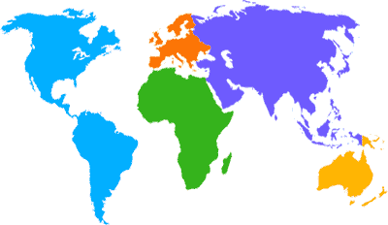
Combining traits is easy.
GoldenBraid assemblies are “reusable” and “ready to transform”
TU1
TU2
TU3
TU4 TU5
3
A
Z
B
2
pDGB_1AB3

Slide 23
Combining traits is easy: a real example
Green Fluorescent
Protein
Silencing
Supressor
Red Fluorescent
Protein
Blue Fluorescent
Protein
A
G
C
C
P
B
C
B
B
A
R
C
35S-GFP-NT
35S-P19-NT
35S-BFP-NT
35S-RED-NT
1
A
Z
B
3
pDGB_1AB3
1
G
B
3
A
G
C
C
B
B

Slide 24
Combining traits is easy: a real example
Green Fluorescent
Protein
Silencing
Supressor
Red Fluorescent
Protein
Blue Fluorescent
Protein
A
G
C
C
P
B
C
B
B
A
R
C
35S-GFP-NT
35S-P19-NT
35S-BFP-NT
35S-RED-NT
Only one day work up to 2X TU assembly!!
1
G
B
3
A
R
C
P
3
R
P
2
C
B
3
A
Z
B
2
pDGB_1AB3

Slide 25
Combining traits is easy: a real example
Green Fluorescent
Protein
Silencing
Supressor
Red Fluorescent
Protein
Blue Fluorescent
Protein
A
G
C
C
P
B
C
B
B
A
R
C
35S-GFP-NT
35S-P19-NT
35S-BFP-NT
35S-RED-NT
A
1
Z
2
C
pDGB_A12C
1
G
B
3
A
G
B
R
P
C
3
R
P
2

Slide 26
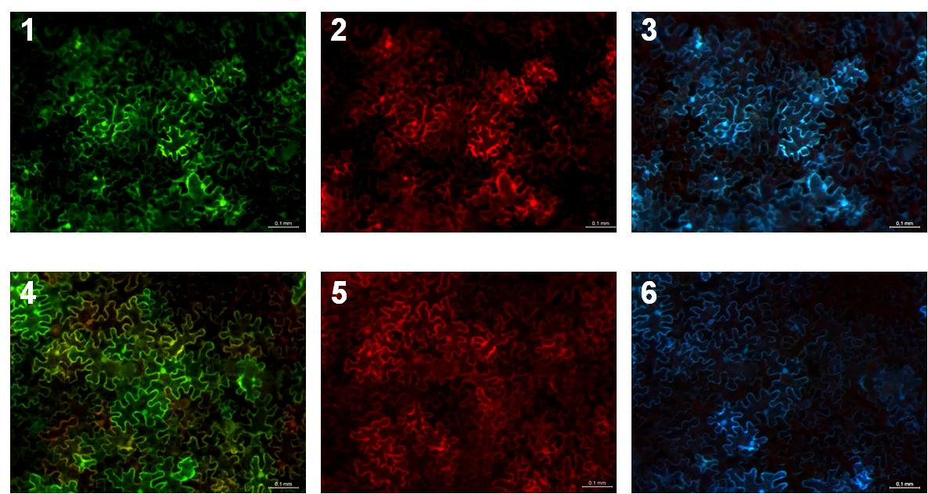
Combining traits is easy: a real example
GB assembly ensures coordinated expression in N. benthamiana
A
G
B
R
P
C
A
R
C
+
C
B
B
+
A
R
C
+
C
P
B

Slide 27
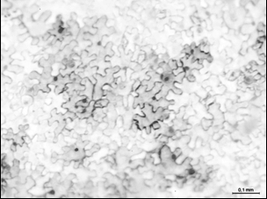
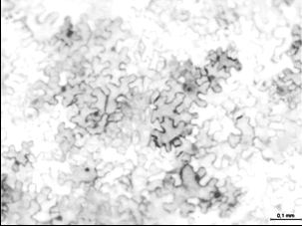
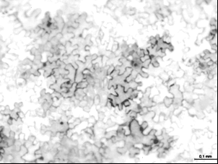
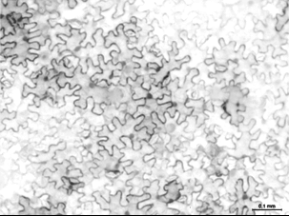
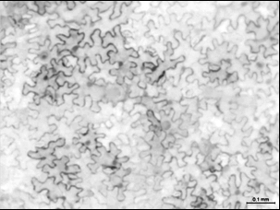
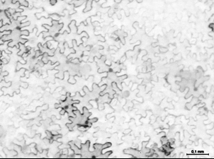
Combining traits is easy: a real example
GB assembly ensures coordinated expression in N. benthamiana
A
G
B
R
P
C
A
R
C
+
C
B
B
+
A
R
C
+
C
P
B

Slide 28
Combining traits is easy.
GoldenBraid allows indefinite binary assemblies of reciclable genetic composites made of standard genetic parts: a versatile tool for complex genetic engineering and synthetic biology in plants.

Slide 29
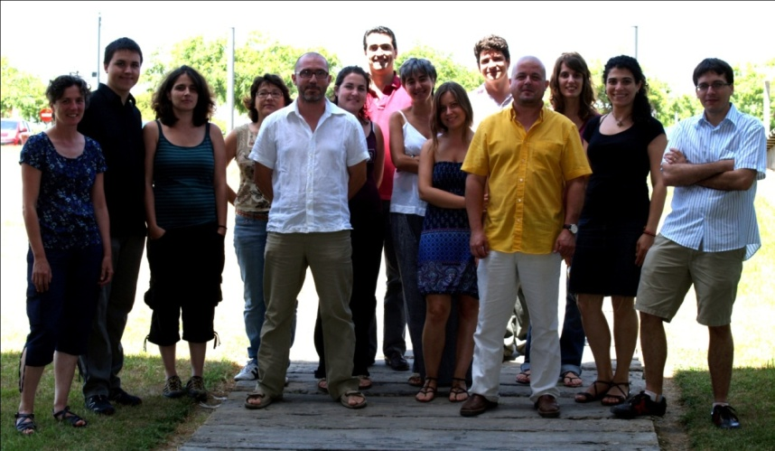
Fruit genomics and Biotechnology Group.
Alejandro Sarrión-Perdigones
Paloma Juárez
Jose Manuel Julve
Asun Fernández
Silvia Presa
Antonio Granell
Diego Orzáez
¡GRACIAS!

